Slide 1


Vishwabharati Academy's college of Engineering
A
Review I
on
“DRUG TRACEABILITY IN HEALTHCARE SUPPLY CHAIN USING BLOCKCHAIN”
Presented By
Mane Kunal Dhananjay
Bendre Abhijit Tarachand
Take Swapnil Rajendra
.
Guided By : Prof. R. N. Devray

Slide 2
Index
Introduction
Motivation
Objectives
Problem Statement
Literature Survey
Existing System
Proposed system
Purpose and Scope of Proposed System
S/W and H/W requirement
Algorithms
Application
Conclusion
References

Slide 3
Introduction
Healthcare supply chains are complex structures spanning across multiple organizational and geographical boundaries, providing critical backbone to services vital for everyday life.
The inherent complexity of such systems can introduce impurities including inaccurate information, lack of transparency and limited data provenance.
Counterfeit drugs is one consequence of such limitations within existing supply chains which not only has serious adverse impact on human health but also causes severe economic loss to the healthcare industry.
Consequently, existing studies have emphasized the need for a robust, end-to-end track and trace system for pharmaceutical supply chains.

Slide 4
Therein, an end-to-end product tracking system across the pharmaceutical supply chain is paramount to ensuring product safety and eliminating counterfeits.
Most existing track and trace systems are centralized leading to data privacy, transparency and authenticity issues in healthcare supply chains.
we present an Ethereum blockchain-based approach leveraging smart contracts and decentralized off-chain storage for efficient product traceability in the healthcare supply chain.
The smart contract guarantees data provenance, eliminates the need for intermediaries and provides a secure, immutable history of transactions to all stakeholders.

Slide 5
Motivation
Healthcare supply chain is a complex network of several independent entities that include raw material suppliers, manufacturer, distributor, pharmacies, hospitals and patients.
Tracking supplies through this network is non-trivial due to several factors including lack of information, centralized control and competing behavior among stakeholders.
Such complexity not only results in inefficiencies such as those highlighted through Frauds but can also aggravate the challenge of mitigating against counterfeit drugs as these can easily permeate the healthcare supply chain.

Slide 6
Objectives
We propose a blockchain-based solution for the pharmaceutical supply chain that provides security, traceability, immutability, and accessibility of data provenance for pharmaceutical drugs.
We design a smart contract capable of handling various transactions among pharmaceutical supply chain stakeholders.
We present, implement and test the smart contract that denes the working principles of our proposed solution.
We conduct security and cost analysis to evaluate the performance of the proposed blockchain-based solution.

Slide 7
Problem Statement
To build and implement drug traceability in healthcare supply chain using block chain

Slide 8
Literature Review
Paper Name | Authors | Year | Technology | Conclusion
A Novel Medical Blockchain Model for Drug Supply Chain Integrity Management in a Smart Hospital | Faisal Jamil , Lei Hang , KyuHyung Kim and DoHyeun Kim | 2019 | Hyperledger | This system solves this problem by conducting drug record transactions on a blockchain to create a smart healthcare ecosystem with a drug supply chain. A smart contract is launched to give time-limited access to electronic drug records and also patient electronic health records
Y. Huang, J.Wu, and C. Long, ``Drugledger:Apractical blockchain system for drug traceability and regulation,'' in Proc. IEEE Conf. Internet Things, Jul./Aug. 2018, pp. 1137_1144. | Yan Huang, Jing Wu, Chengnian Long | 2019 | bitcoin | This system propose a scenario-oriented blockchain system for drug traceability and regulation called Drugledger, which reconstructs the whole service architecture by separating service provider into three independent service components and ensures the authenticity and privacy of traceability data.
Analysis of the bitcoin UTXO set | S. Delgado-Segura, C. Pérez-Solà, G. Navarro-Arribas, and J. HerreraJoancomartí | 2019 | Bitcoin | This analysis includes a general view of the set and quantifies the difference between the two existing formats up to the date. We also provide an accurate analysis of the volume of dust and unprofitable outputs included in the set, the distribution of the block height in which the outputs where included, and the use of non-standard outputs.

Slide 9
Literature Review
Investigating performance constraints for blockchain based secure e-voting system | K. M. Khan, J. Arshad, and M. M. Khan | 2020 | Bitcoin | In this paper, we present our efforts to address this gap by presenting a detailed study into performance and scalability constraints for an e-voting system. Specifically, we conducted rigorous experimentation with permissioned and permissionless blockchain settings across different scenarios with respect to voting population, block size, block generation rate and transaction speed.
D. Vujicic, D. Jagodic, and S. Randic | Blockchain technology, bitcoin, and Ethereum: A brief overview | 2019 | bitcoin, and Ethereum | The blockchain technology is a relatively new approach in the field of information technologies. As one of its first implementations, bitcoin as a cryptocurrency has gained a lot of attention. Together with Ethereum, blockchain implementation with focus on smart contracts, they represent the very core of modern cryptocurrency development. This paper is meant to give a brief introduction to these topics.

Slide 10
Existing System
Limited data used

Slide 11
Proposed System
Our method identifies and involves significant stakeholders in the medication supply chain, such as the FDA, suppliers, manufacturers, distributors, pharmacies, and patients, whereas the FDA, suppliers, manufacturers, and wholesalers are the only ones involved.
We make a concerted effort to identify and disentangle linkages between stakeholders, on-chain resources, smart contracts, and decentralised storage systems, which is currently lacking.

Slide 12
Proposed System
We use smart contracts technology to achieve real-time, seamless traceability with push alerts, reducing the need for human intervention and, as a result, unnecessary delays.
Each drug Lot is given its own smart contract, which generates an event whenever there is a change in ownership and sends a list of events to the app user.

Slide 13
Purpose and Scope
A blockchain system for drug traceability and regulation is presented. As time goes on, it rebuilds the entire service architecture, ensuring the authenticity and privacy of traceability data, while at the same time, achieving a finally stable blockchain storage There have also been presented algorithms that mirror the practical workflow of the medication supply chain.

Slide 14
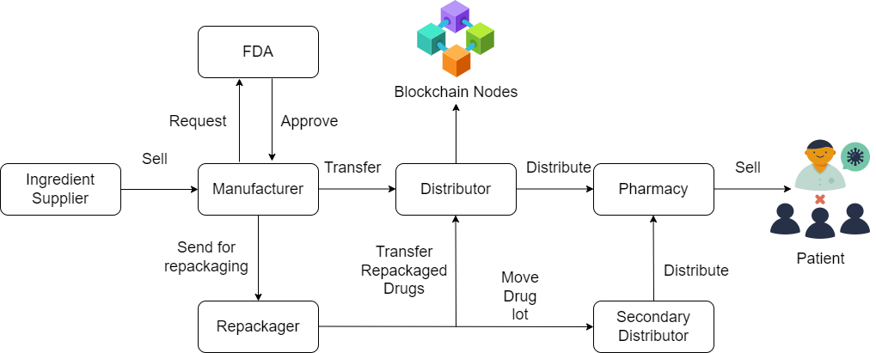
System Architecture

Slide 15
S/W requirement
Operating System - Windows
Application Server - Apache Tomcat
Front End - HTML, JDK 1.7, JSP
Scripts - JavaScript.
Server side Script - Java Server Pages.
Database - My SQL 5.0
IDE - Eclipse

Slide 16
H/W requirement
Processor - i3/i5/i7
Speed - 1.1 GHz
RAM - 4 GB(min)
Hard Disk - 20 GB

Slide 17
Application
Medical Application
Healthcare Application

Slide 18
Conclusion
In this system, we have investigated the challenge of drug traceability within pharmaceutical supply chains highlighting its significance especially to protect against counterfeit drugs.
We have developed and evaluated a blockchain-based solution for the pharmaceutical supply chain to track and trace drugs in a decentralized manner.
Specifically, our proposed solution leverages cryptographic fundamentals underlying blockchain technology to achieve tamper-proof logs of events within the supply chain and utilizes smart contracts within Ethereum blockchain to achieve automated recording of events that are accessible to all participating stakeholders.

Slide 19
References
F. Jamil, L. Hang, K. Kim, and D. Kim, ``A novel medical blockchain model for drug supply chain integrity management in a smart hospital,'' Electronics, vol. 8, p. 505, Apr. 2019, doi: 10.3390/electronics8050505.
Y. Huang, J.Wu, and C. Long, ``Drugledger:Apractical blockchain system for drug traceability and regulation,'' in Proc. IEEE Conf. Internet Things, Jul./Aug. 2018, pp. 1137_1144.
S. Delgado-Segura, C. Pérez-Solà, G. Navarro-Arribas, and J. HerreraJoancomartí, ``Analysis of the bitcoin UTXO set,'' in Financial Cryptography and Data Security (Lecture Notes in Computer Science), vol. 10958, A. Zohar, Ed. Berlin, Germany: Springer, 2019, pp. 78_91.
K. M. Khan, J. Arshad, and M. M. Khan, ``Investigating performance constraints for blockchain based secure e-voting system,'' Future Gener. Comput. Syst., vol. 105, pp. 13_26, Apr. 2020.
D. Vujicic, D. Jagodic, and S. Randic, ``Blockchain technology, bitcoin, and Ethereum: A brief overview,'' in Proc. 17th Int. Symp. Infoteh- Jahorina (INFOTEH), East Sarajevo, Srpska, Mar. 2018, pp. 1_6, doi: 10.1109/INFOTEH.2018.8345547.
S. Jiang, J. Cao, H. Wu, Y. Yang, M. Ma, and J. He, ‘‘BlocHIE: A blockchain- based platform for healthcare information exchange,’’ in Proc. IEEE Int. Conf. Smart Comput. (SMARTCOMP), Jun. 2018, pp. 49–56.
W. J. Gordon and C. Catalini, ‘‘Blockchain technology for healthcare: Facilitating the transition to patient-driven interoperability,’’ Comput. Struct. Biotechnol J., vol. 16, pp. 224–230, 2018.
Anjia yang, Wei Lu, Yue Zhang, Lin Hou” CrowdBC: A Blockchain-based Decentralized a Framework for Crowdsourcing” IEEE , vol. 7, May.2018.
S. Wang, Y. Zhang, and Y. Zhang, ‘‘A blockchain-based framework for data sharing with fine-grained access control in decentralized storage systems,’’ IEEE Access, vol. 6, pp. 38437–38450, Jun.2018.
M. Steichen, R. Norvill, B. F. Pontiveros, and W. Shbair,‘‘Blockchainbased, decentralized access control for IPFS,’’ in Proc. IEEE Blockchain, Jul. 2018, pp. 1499–1506.

Slide 20
THANK YOU…

Slide 21
Any Questions?

